Slide 1
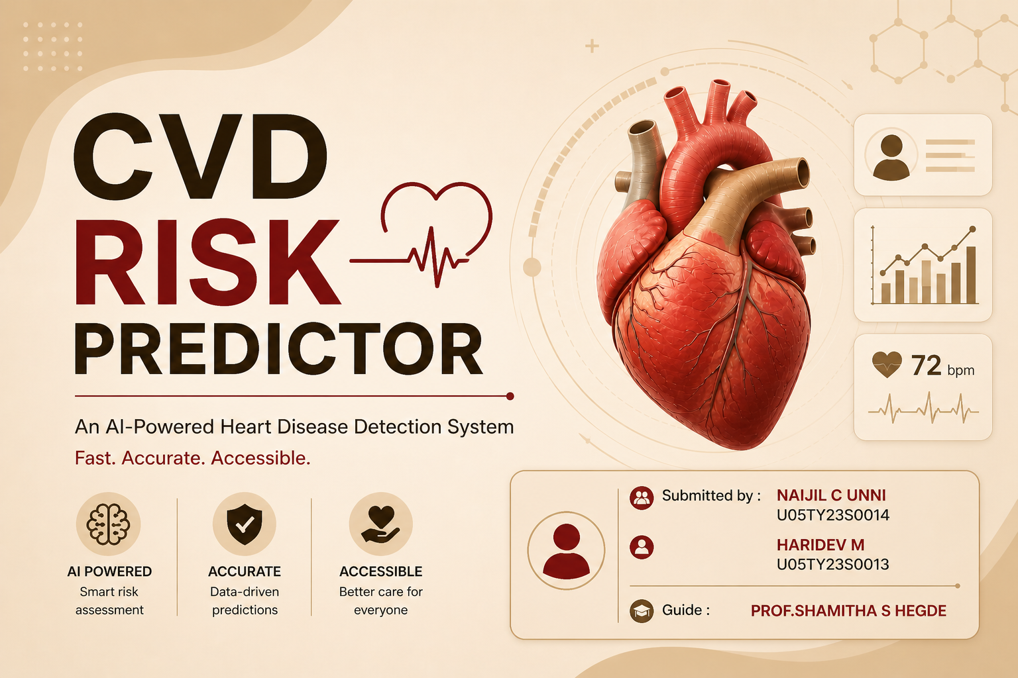

THE YENEPOYA COLLEGE
N.H.13,Thodar,MOODBIDRI-574225,Mangalore,D.K.

Slide 2
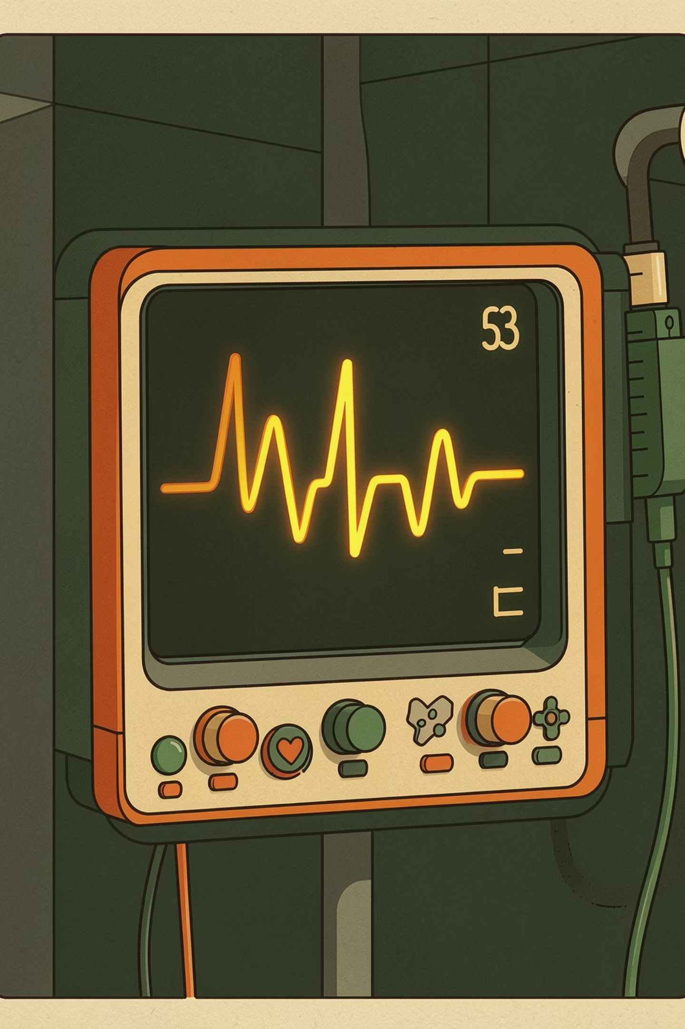
Introduction
Cardiovascular disease is one of the leading causes of death worldwide, and it is often detected too late. Early identification of risk can help prevent serious health problems and save lives.
The CVD Risk Predictor is an AI-based system that analyzes patient data to provide quick and accurate risk assessments. It helps doctors and patients identify potential heart risks early and take the right steps for prevention.

Slide 3

Why Early Detection Matters
Leading Cause of Death
The Detection Gap
Cardiovascular disease accounts for approximately 1 in 5 deaths in the U.S., making it the nation's most critical health challenge.
Millions go undiagnosed until symptoms become severe — early identification dramatically improves patient outcomes and survival rates.
AI as a Force Multiplier
Machine learning models can analyze complex patient data in seconds, enabling faster, more consistent risk predictions at scale.

Slide 4
Project Objectives
Accurate Prediction
Real-Time Results
User-Friendly System
Leverage a trained ONNX machine learning model to classify cardiovascular risk with clinically meaningful precision across diverse patient profiles.
Deliver risk assessments within seconds of data submission — no waiting, no delays — enabling immediate clinical decision-making.
Design an intuitive interface that clinicians and patients alike can navigate with minimal training, reducing friction at every step.

Slide 5

PROBLEM STATEMENT
The Barriers to Timely Care
Late Diagnosis
CVD is frequently identified only after a critical event, leaving little time for preventive intervention.
High-Cost Testing
Imaging, stress tests, and specialist consultations are expensive and inaccessible for many patients.
Limited Access
Rural and underserved communities lack the infrastructure needed for timely cardiovascular screening.

Slide 6
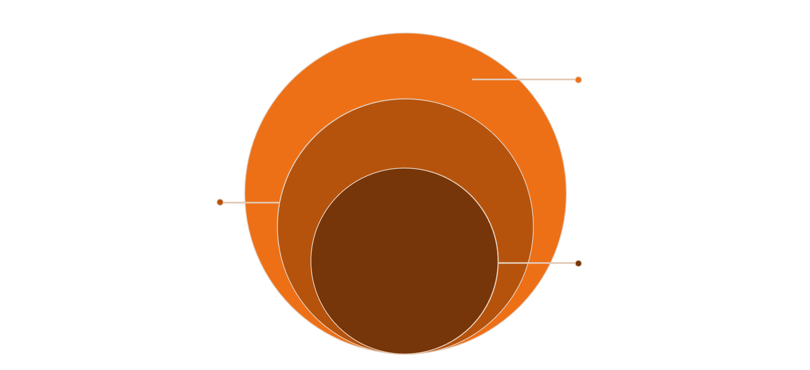
System Architecture
Backend & AI
Node.js/Express API and ONNX risk inference
Frontend
React UI styled with Tailwind CSS
User Entry
Patient or clinician submits data via browser
The system follows a clean, layered architecture — separating concerns across the UI, API, and inference engine — ensuring maintainability, scalability, and security at every tier.

Slide 7




How It Works
Input
Processing
Patient enters clinical indicators such as age, blood pressure, cholesterol, and lifestyle factors.
The backend API validates and normalizes inputs before routing them to the inference engine.
Prediction
Output
The ONNX model evaluates the data and computes a risk score in real time.
The user receives a clear Low, Medium, or High risk classification with actionable guidance.

Slide 8
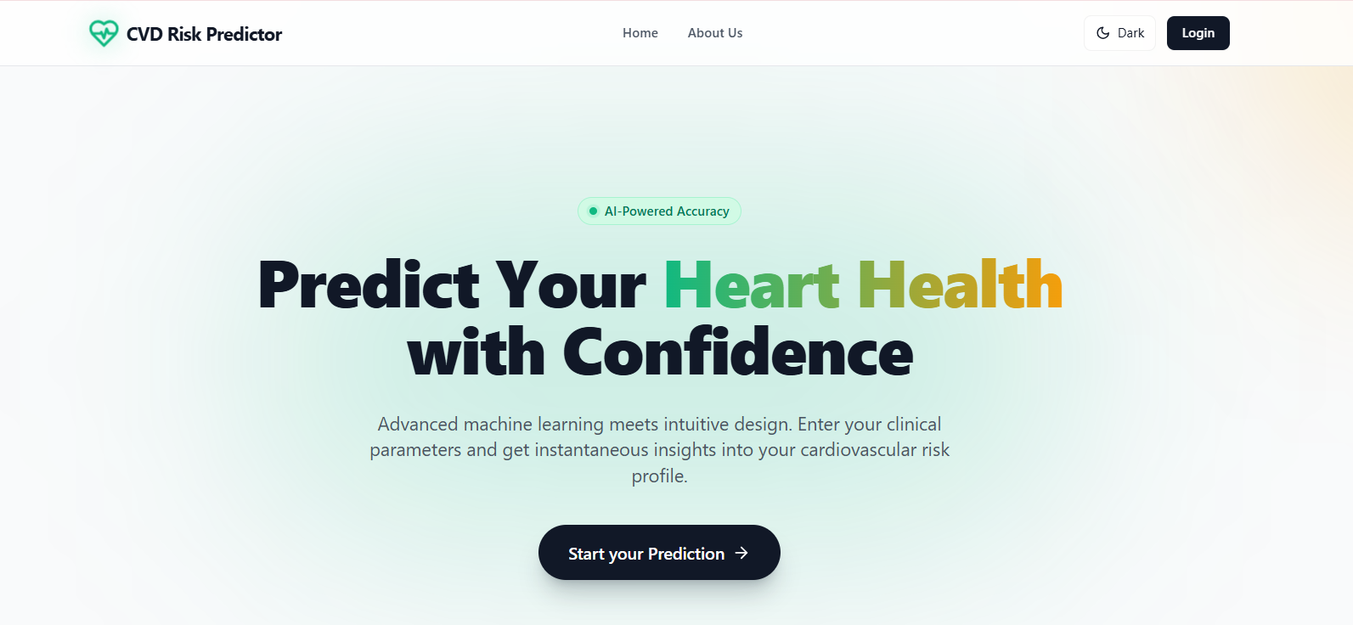
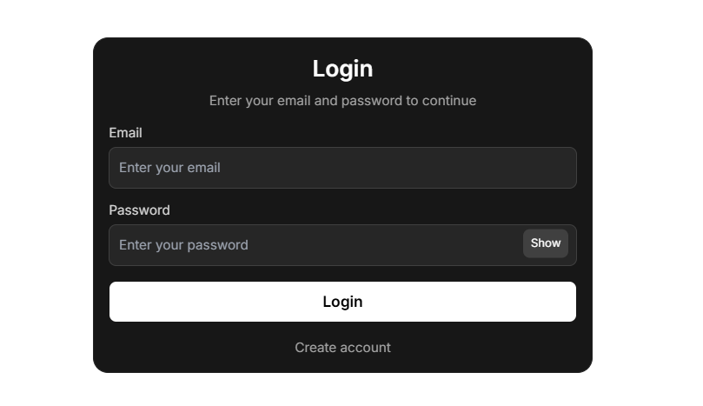
Implementation & Screenshots
Home Page
Sign up/ Login

Slide 9
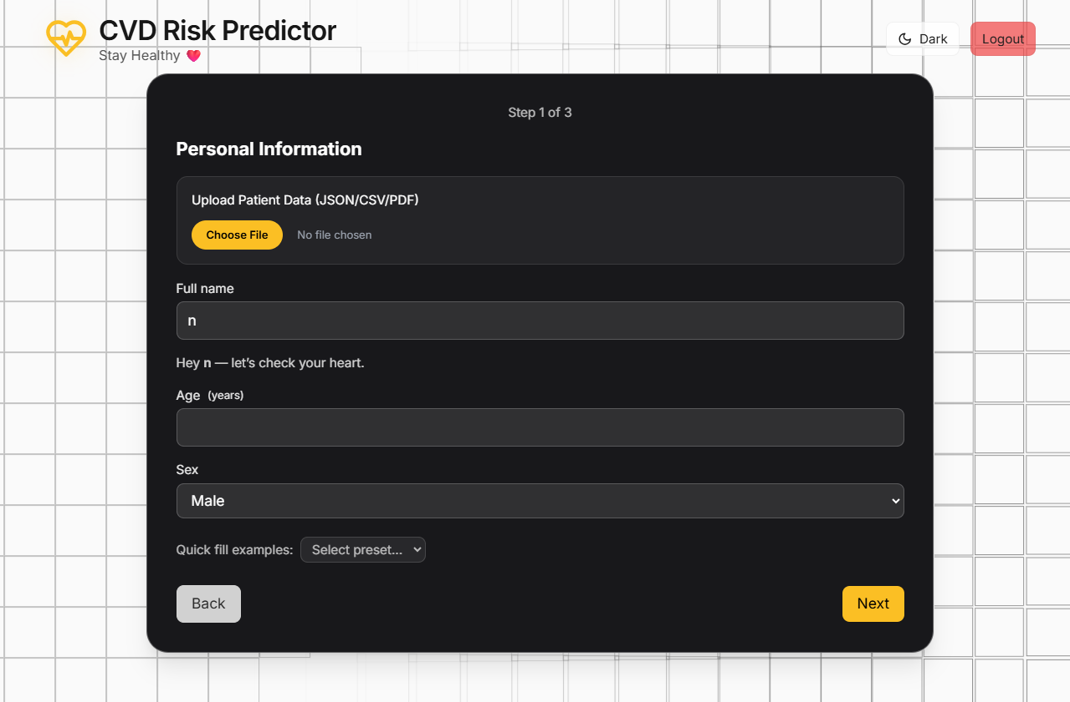
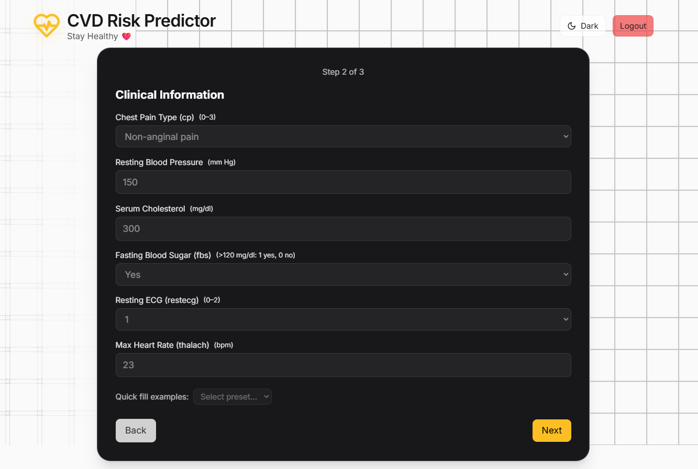
Implementation & Screenshots
Analysis
Dashboard

Slide 10
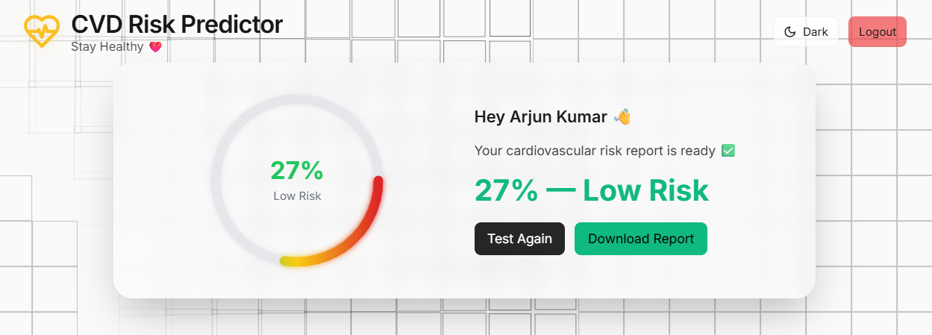
Implementation & Screenshots
Final Result

Slide 11
TECH STACK
Technologies Used
React + Tailwind CSS
Node.js + Express
Built on a modern, production-ready stack — each technology chosen for performance, developer ergonomics, and seamless deployment across cloud environments.
Lightweight REST API for secure data routing
Responsive, accessible UI with utility-first styling
ONNX Runtime
Vercel + Render
Cross-platform ML model inference at low latency
CI/CD-enabled cloud deployment for frontend and backend

Slide 12

Results at a Glance
🟢 Low Risk
🟡 Medium Risk
Patient profile indicates minimal cardiovascular concern — recommended for routine monitoring.
Elevated indicators detected — clinician review and lifestyle intervention recommended.
🔴 High Risk
Significant risk factors present — immediate follow-up and advanced diagnostics advised.
Predictions are returned in under two seconds, with model accuracy validated against benchmark cardiovascular datasets.

Slide 13



Key Advantages
Fast
Secure
Accessible
Sub-second inference means clinicians receive risk scores instantly — no bottlenecks, no waiting rooms left in the dark.
Patient data is handled with strict privacy standards. No sensitive information is stored post-inference, minimizing exposure.
Fully browser-based and mobile-responsive — available to clinicians and patients regardless of location or device.

Slide 14
WHAT'S NEXT
Doctor Integration
Future Scope
Connect predictions directly to EHR systems, enabling physicians to act on risk scores within their existing workflows.
The CVD Risk Predictor is built for growth. The roadmap ahead focuses on deeper integration, broader reach, and collaborative care — evolving from a standalone tool into a connected clinical ecosystem.
Mobile App
A dedicated iOS and Android app will bring risk screening to patients wherever they are.
Wearable Integration
Sync real-time biometric data from wearables to enable continuous, passive cardiovascular monitoring.

Slide 15
Conclusion
The CVD Risk Predictor successfully demonstrates how AI can be used for early detection of heart disease.
The system provides fast, accurate, and real-time risk assessment using clinical and lifestyle data.
Its user-friendly web interface makes it accessible to a wide range of users without medical expertise.
The project promotes preventive healthcare by helping users take timely action.
Overall, it shows the potential of combining machine learning and modern web technologies to improve healthcare accessibility and efficiency.

Slide 16
THANK YOU

